Slide 1
Final Project Proposal
By Jacqueline Wang

Slide 2
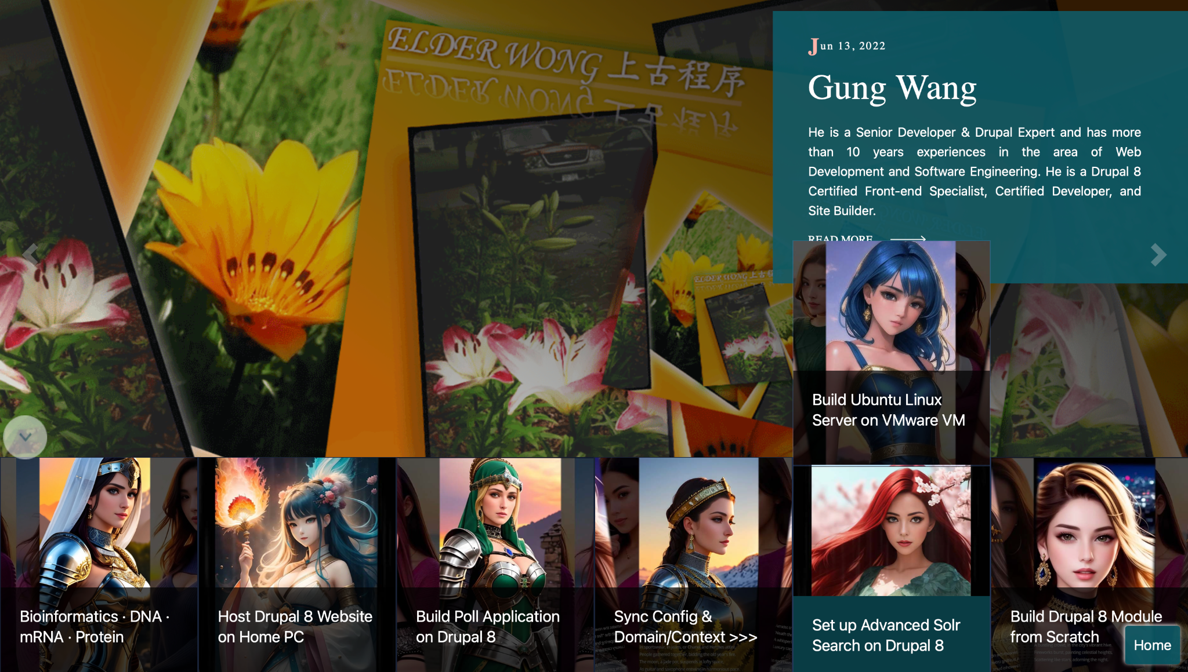
Demo https://gungwang.com/

Slide 3
Materials
Bootstrap
Slideshow
interactive

Slide 4
